Slide 1

SIT1302 Internet Programming
UNIT 1
MARKUP LANGUAGE

Slide 2
Introduction to HTML
HTML stands for Hyper Text Markup Language.
HTML is the standard markup language for creating Web pages and Web Applications.
HTML describes the structure of Web pages using markup.
HTML elements are the building blocks of HTML pages.
HTML elements are represented by tags.
HTML tags label pieces of content such as "heading", "paragraph", "table", and so on
Browsers do not display the HTML tags, but use them to render the content of the page.

Slide 3
HTML Tags
HTML tags are element names surrounded by angle brackets:
<tagname>content goes here...</tagname>

Slide 4
Page Structure
<html>
</html>
head
<head>
<title>Page title</title>
</head>
<body>
<h1>This is a heading</h1>
<p>This is a paragraph.</p>
<p>This is another paragraph.</p>
</body>
body

Slide 5
My First Page
<!DOCTYPE html>
<html>
<head>
<title>Page Title</title>
</head>
<body>
<h1>My First Heading</h1>
<p>My first paragraph.</p>
</body>
</html>

Slide 6
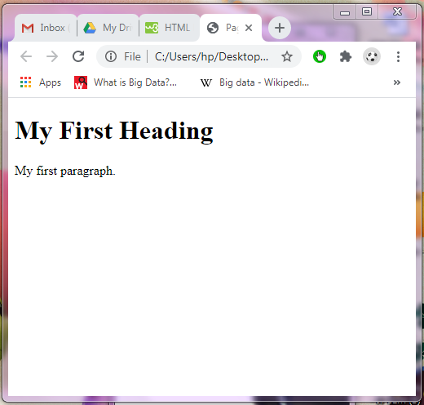
Output

Slide 7
HTML Attributes
All HTML elements can have attributes
Attributes provide additional information about an element
Attributes are always specified in the start tag
Attributes usually come in name/value pairs like: name="value"
Example
<html lang="en-US">
attribute name attribute value

Slide 8
Formatting Page Contents
Formatting elements were designed to display special types of text:
<b> - Bold text
<strong> - Important text
<i> - Italic text
<em> - Emphasized text
<mark> - Marked text
<big> - Big text
<small> - Small text

Slide 9
Continued…
<del> - Deleted text
<ins> - Inserted text
<sub> - Subscript text
<sup> - Superscript text
<center> - Text will be center aligned
<br> - Line break
<hr> - Horizontal ruler
<marquee> - scrolling piece of text or image displayed either horizontally across or vertically

Slide 10
Syntax
<b> Element
<b>This text is bold</b>
<strong> Element
<strong>This text is strong</strong>
<i> Element
<i>This text is italic</i>
<em> Element
<em>This text is emphasized</em>
<ins> Element
<p>My favorite <ins>color</ins> is red.</p>

Slide 11
Syntax
<small> Element
<h3>HTML <small>Small</small> Formatting</h3>
<mark> Element
<h2>HTML<mark>Marked</mark>Formatting</h2>
<del> Element
<p>My favourite colour is <del>pink</del> green.</p>
<sub> Element
<p>This is <sub>subscripted</sub> text.</p>
<sup> Element
<p>This is <sup>superscripted</sup> text.</p>

Slide 12
Syntax
<hr> Tag
<html>
<body>
<h1>HTML</h1>
<p>HTML is a language for describing web pages.</p>
<hr>
<h1>CSS</h1>
<p>CSS defines how to display HTML elements.</p>
</body>
</html>

Slide 13
Syntax
<br> Tag
<html>
<body>
<p>
To break lines<br>in a text,<br>use the br element.
</p>
</body>
</html>

